Slide 1
Programming
2015.5.11, PPR meeting
Damien Zufferey
Ongoing work with Martin, Stelios, Aleks, Ankur, Joseph, …

Slide 2
Outline
Single robot
REACT (updated version)
Linking the code to the physical world using the robot design
Group coordination
Coordination, time, and faults

Slide 3
Single robot: REACT

Slide 4
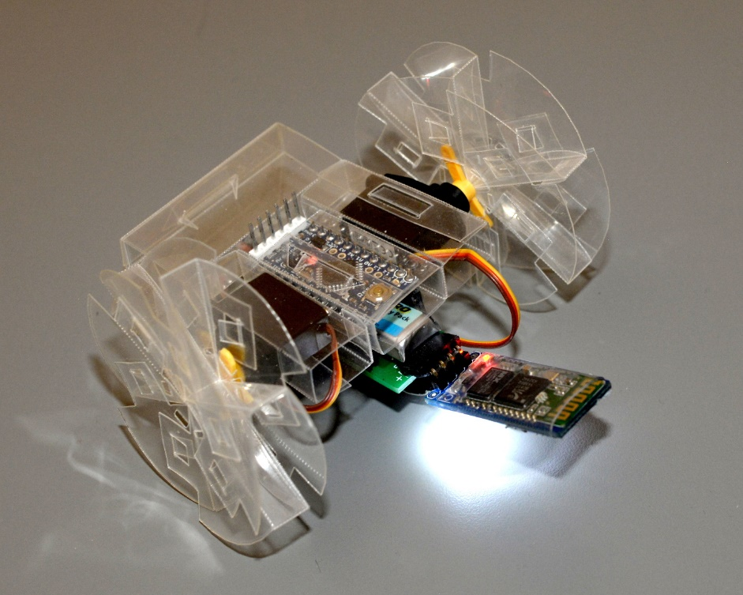
“Full stack” robot compiler and verifier
Controller program
+
Robot specification
REACT
Compiler
Robot
Compiler
Verifier
3D printer,
Laser cutter
Counter-example
Robot
Notes:
Mathias Althoff!

Slide 5
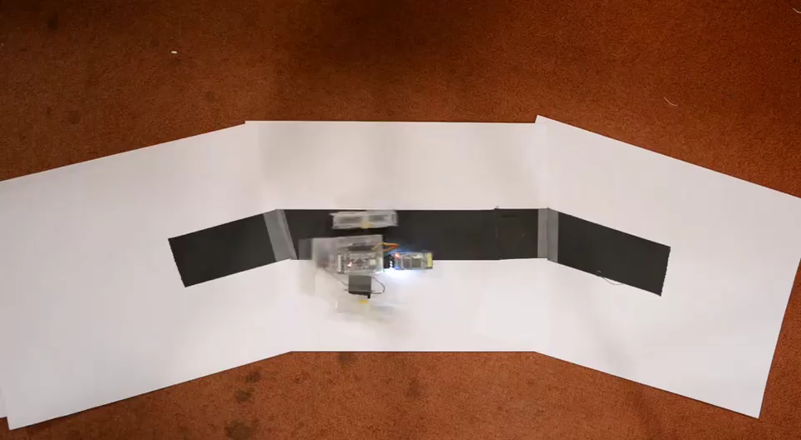
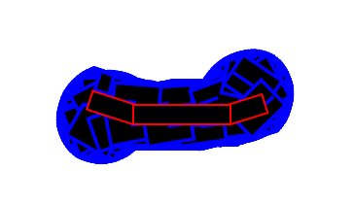
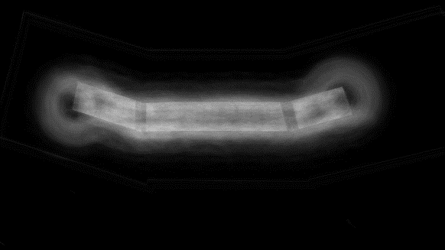
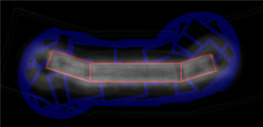
Example: Line Follower
Verifier
State-space coverage
Background subtraction

Slide 6
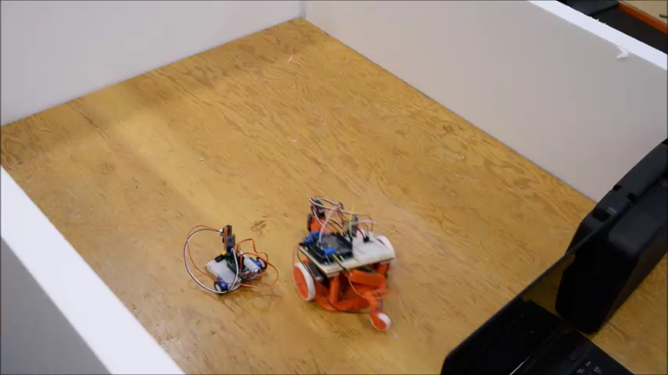
Example: avoiding collisions
Speed: 2x

Slide 7
Disclaimer
For the proof of concept we used hand made models of the robot’s dynamic.
Unfortunately, the phd-in-the-loop approach does not scale …
We are currently try to automate that part.

Slide 8
React: basic concepts
Finite state machine: a controller has states or modes
Periodic loop:
Fixed period
Executes in parallel
Can be global or inside states
Event handlers:
Passive or active (polling)
Can be global or inside states

Slide 9
Concretely
var onTarget = false
sensor[Bool](sensorPort){
case Bool(b) => onTarget = b
}
every(300) {
if (onTarget) {
publish(servoLeft, Int16(5))
publish(servoRight, Int16(0))
} else {
publish(servoLeft, Int16(0))
publish(servoRight, Int16(5))
}
}
Event handler
Periodic loop
Sending messages
(also to hardware)
State:
state('loop) {
on { case Key.UP => nextState('moving) }
}
state('moving) { every(100){ ... } }

Slide 10
Reasoning about the effect of the code on the physical robot
State-space exploration for hybrid systems
discrete transition: controller
continuous transitions: robot
Controller: timed automata
as simple as it can get
Robot: non-linear differential algebraic equations
So complicated that you need to change your model of computation
(type 2 computability) to be able to do anything …

Slide 11
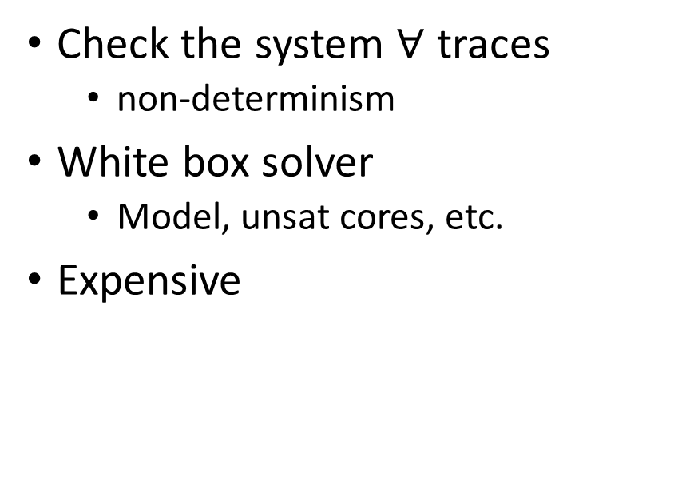
Simulation vs Verification
Verification
Simulation
Check the system $∀$ traces
non-determinism
White box solver
Model, unsat cores, etc.
Expensive
Check one trace at the time
Black box solver
Best-effort numerical method
Cheap

Slide 12
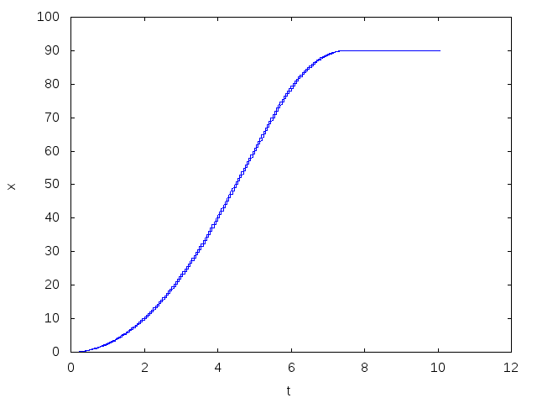
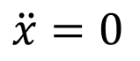
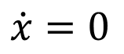
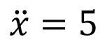
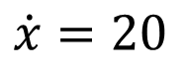
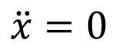
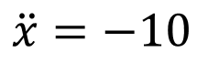
Hybrid system: example
Spherical car moving along a line in frictionless vacuum.
accelerate
$$\dot{x}=20$$
cruise
brake
$$\ddot{x}=5$$
$$\ddot{x}=0$$
stopped
obstacle
accelerate
brake
$$\dot{x}=0$$
stopped
cruise
$$\ddot{x}=−10$$
$$\ddot{x}=0$$

Slide 13
Equations for the Seg
== beam.dz rightmotor.dz )
( == beam.dx rightmotor.dx )
( == beam.dy rightmotor.dy )
( == ( + ( ^ beam.q_k 2 ) ( ^ beam.q_i 2 ) ( ^ beam.q_a 2 ) ( ^ beam.q_j 2 ) ) 1 )
( == ( + ( ^ tail.q_j 2 ) ( ^ tail.q_i 2 ) ( ^ tail.q_k 2 ) ( ^ tail.q_a 2 ) ) 1 )
( == ( + ( ^ rightmotor.q_j 2 ) ( ^ rightmotor.q_i 2 ) ( ^ rightmotor.q_a 2 ) ( ^ rightmotor.q_k 2 ) ) 1 )
( == ( D rightmotor.angle ) ( * rightmotor.input 1 ) )
( == ( + ( ^ rightwheel.q_i 2 ) ( ^ rightwheel.q_a 2 ) ( ^ rightwheel.q_j 2 ) ( ^ rightwheel.q_k 2 ) ) 1 )
( == ( + ( ^ leftwheel.q_j 2 ) ( ^ leftwheel.q_a 2 ) ( ^ leftwheel.q_k 2 ) ( ^ leftwheel.q_i 2 ) ) 1 )
( == ( + ( ^ leftmotor.q_i 2 ) ( ^ leftmotor.q_a 2 ) ( ^ leftmotor.q_j 2 ) ( ^ leftmotor.q_k 2 ) ) 1 )
( == ( D leftmotor.angle ) ( * leftmotor.input 1 ) )
( == ( + ( ^ beam.q_k 2 ) ( * -1 ( ^ beam.q_i 2 ) ) ( ^ beam.q_a 2 ) ( * -1 ( ^ beam.q_j 2 ) ) ) ( + ( * -1 ( ^ rightmotor.q_j 2 ) ) ( * -1 ( ^ rightmotor.q_i 2 ) ) ( ^ rightmotor.q_a 2 ) ( ^ rightmotor.q_k 2 ) ) )
( == ( + ( * 2 beam.q_a beam.q_i ) ( * 2 beam.q_j beam.q_k ) ) ( + ( * 2 rightmotor.q_a rightmotor.q_i ) ( * 2 rightmotor.q_j rightmotor.q_k ) ) )
( == ( + ( * -2 beam.q_a beam.q_j ) ( * 2 beam.q_i beam.q_k ) ) ( + ( * 2 rightmotor.q_i rightmotor.q_k ) ( * -2 rightmotor.q_a rightmotor.q_j ) ) )
( == ( + ( * 2 beam.q_i beam.q_j ) ( * -2 beam.q_a beam.q_k ) ) ( + ( * 2 rightmotor.q_i rightmotor.q_j ) ( * -2 rightmotor.q_a rightmotor.q_k ) ) )
( == ( + ( * -1 ( ^ beam.q_k 2 ) ) ( ^ beam.q_i 2 ) ( ^ beam.q_a 2 ) ( * -1 ( ^ beam.q_j 2 ) ) ) ( + ( * -1 ( ^ rightmotor.q_j 2 ) ) ( ^ rightmotor.q_i 2 ) ( ^ rightmotor.q_a 2 ) ( * -1 ( ^ rightmotor.q_k 2 ) ) ) )
( == ( + ( * 2 beam.q_i beam.q_j ) ( * 2 beam.q_a beam.q_k ) ) ( + ( * 2 rightmotor.q_i rightmotor.q_j ) ( * 2 rightmotor.q_a rightmotor.q_k ) ) )
( == ( + ( * 2 beam.q_a beam.q_j ) ( * 2 beam.q_i beam.q_k ) ) ( + ( * 2 rightmotor.q_i rightmotor.q_k ) ( * 2 rightmotor.q_a rightmotor.q_j ) ) )
( == ( + ( * -1 ( ^ beam.q_k 2 ) ) ( * -1 ( ^ beam.q_i 2 ) ) ( ^ beam.q_a 2 ) ( ^ beam.q_j 2 ) ) ( + ( * -1 ( ^ rightmotor.q_i 2 ) ) ( ^ rightmotor.q_j 2 ) ( ^ rightmotor.q_a 2 ) ( * -1 ( ^ rightmotor.q_k 2 ) ) ) )
( == ( + ( * -2 beam.q_a beam.q_i ) ( * 2 beam.q_j beam.q_k ) ) ( + ( * -2 rightmotor.q_a rightmotor.q_i ) ( * 2 rightmotor.q_j rightmotor.q_k ) ) )
( == ( + ( * -1 ( ^ rightmotor.q_j 2 ) ) ( * -1 ( ^ rightmotor.q_i 2 ) ) ( ^ rightmotor.q_a 2 ) ( ^ rightmotor.q_k 2 ) ) ( + ( ^ rightwheel.q_a 2 ) ( * -1 ( ^ rightwheel.q_j 2 ) ) ( * -1 ( ^ rightwheel.q_i 2 ) ) ( ^ rightwheel.q_k 2 ) ) )
( ==
( + ( * ( + ( * 2 rightmotor.q_a rightmotor.q_i ) ( * 2 rightmotor.q_j rightmotor.q_k ) ) ( cos rightmotor.angle ) )
( * -1 ( + ( * 2 rightmotor.q_i rightmotor.q_k ) ( * -2 rightmotor.q_a rightmotor.q_j ) ) ( sin rightmotor.angle ) ) )
( + ( * 2 rightwheel.q_j rightwheel.q_k )
( * 2 rightwheel.q_a rightwheel.q_i ) ) )
( ==
( + ( * ( + ( * 2 rightmotor.q_a rightmotor.q_i ) ( * 2 rightmotor.q_j rightmotor.q_k ) ) ( sin rightmotor.angle ) )
( * ( + ( * 2 rightmotor.q_i rightmotor.q_k ) ( * -2 rightmotor.q_a rightmotor.q_j ) ) ( cos rightmotor.angle ) ) )
( + ( * 2 rightwheel.q_i rightwheel.q_k )
( * -2 rightwheel.q_a rightwheel.q_j ) ) )
( == ( + ( * ( + ( * 2 rightmotor.q_i rightmotor.q_j ) ( * -2 rightmotor.q_a rightmotor.q_k ) ) ( cos rightmotor.angle ) ) ( * -1 ( + ( * -1 ( ^ rightmotor.q_j 2 ) ) ( ^ rightmotor.q_i 2 ) ( ^ rightmotor.q_a 2 ) ( * -1 ( ^ rightmotor.q_k 2 ) ) ) ( sin rightmotor.angle ) ) ) ( + ( * -2 rightwheel.q_a rightwheel.q_k ) ( * 2 rightwheel.q_i rightwheel.q_j ) ) )
( == ( + ( * ( + ( * -1 ( ^ rightmotor.q_j 2 ) ) ( ^ rightmotor.q_i 2 ) ( ^ rightmotor.q_a 2 ) ( * -1 ( ^ rightmotor.q_k 2 ) ) ) ( cos rightmotor.angle ) ) ( * ( + ( * 2 rightmotor.q_i rightmotor.q_j ) ( * -2 rightmotor.q_a rightmotor.q_k ) ) ( sin rightmotor.angle ) ) ) ( + ( ^ rightwheel.q_i 2 ) ( ^ rightwheel.q_a 2 ) ( * -1 ( ^ rightwheel.q_k 2 ) ) ( * -1 ( ^ rightwheel.q_j 2 ) ) ) )
( == ( + ( * ( + ( * 2 rightmotor.q_i rightmotor.q_j ) ( * 2 rightmotor.q_a rightmotor.q_k ) ) ( cos rightmotor.angle ) ) ( * ( + ( * -1 ( ^ rightmotor.q_i 2 ) ) ( ^ rightmotor.q_j 2 ) ( ^ rightmotor.q_a 2 ) ( * -1 ( ^ rightmotor.q_k 2 ) ) ) ( sin rightmotor.angle ) ) ) ( + ( * 2 rightwheel.q_a rightwheel.q_k ) ( * 2 rightwheel.q_i rightwheel.q_j ) ) )
( == ( + ( * 2 rightmotor.q_i rightmotor.q_k ) ( * 2 rightmotor.q_a rightmotor.q_j ) ) ( + ( * 2 rightwheel.q_i rightwheel.q_k ) ( * 2 rightwheel.q_a rightwheel.q_j ) ) )
( == ( + ( * ( + ( * -1 ( ^ rightmotor.q_i 2 ) ) ( ^ rightmotor.q_j 2 ) ( ^ rightmotor.q_a 2 ) ( * -1 ( ^ rightmotor.q_k 2 ) ) ) ( cos rightmotor.angle ) ) ( * -1 ( + ( * 2 rightmotor.q_i rightmotor.q_j ) ( * 2 rightmotor.q_a rightmotor.q_k ) ) ( sin rightmotor.angle ) ) ) ( + ( ^ rightwheel.q_a 2 ) ( * -1 ( ^ rightwheel.q_k 2 ) ) ( ^ rightwheel.q_j 2 ) ( * -1 ( ^ rightwheel.q_i 2 ) ) ) )
( == ( + ( * 16 ( + ( * -1 ( ^ rightmotor.q_j 2 ) ) ( * -1 ( ^ rightmotor.q_i 2 ) ) ( ^ rightmotor.q_a 2 ) ( ^ rightmotor.q_k 2 ) ) ) rightmotor.dz ) rightwheel.dz )
( == ( + rightmotor.dx ( * 16 ( + ( * 2 rightmotor.q_i rightmotor.q_k ) ( * 2 rightmotor.q_a rightmotor.q_j ) ) ) ) rightwheel.dx )
( == ( + rightmotor.dy ( * 16 ( + ( * -2 rightmotor.q_a rightmotor.q_i ) ( * 2 rightmotor.q_j rightmotor.q_k ) ) ) ) rightwheel.dy )
( == ( + ( * -2 rightmotor.q_a rightmotor.q_i ) ( * 2 rightmotor.q_j rightmotor.q_k ) ) ( + ( * 2 rightwheel.q_j rightwheel.q_k ) ( * -2 rightwheel.q_a rightwheel.q_i ) ) )
( == ( + ( * -1 ( ^ beam.q_k 2 ) ) ( ^ beam.q_i 2 ) ( * -1 ( ^ beam.q_a 2 ) ) ( ^ beam.q_j 2 ) ) ( + ( ^ leftmotor.q_a 2 ) ( * -1 ( ^ leftmotor.q_i 2 ) ) ( * -1 ( ^ leftmotor.q_j 2 ) ) ( ^ leftmotor.q_k 2 ) ) )
( == ( + ( * 2 beam.q_a beam.q_i ) ( * 2 beam.q_j beam.q_k ) ) ( + ( * 2 leftmotor.q_j leftmotor.q_k ) ( * 2 leftmotor.q_a leftmotor.q_i ) ) )
( == ( + ( * 2 beam.q_a beam.q_j ) ( * -2 beam.q_i beam.q_k ) ) ( + ( * -2 leftmotor.q_a leftmotor.q_j ) ( * 2 leftmotor.q_i leftmotor.q_k ) ) )
( == ( + ( * 2 beam.q_i beam.q_j ) ( * -2 beam.q_a beam.q_k ) ) ( + ( * 2 leftmotor.q_i leftmotor.q_j ) ( * -2 leftmotor.q_a leftmotor.q_k ) ) )
( == ( + ( ^ beam.q_k 2 ) ( * -1 ( ^ beam.q_a 2 ) ) ( * -1 ( ^ beam.q_i 2 ) ) ( ^ beam.q_j 2 ) ) ( + ( * -1 ( ^ leftmotor.q_k 2 ) ) ( ^ leftmotor.q_i 2 ) ( ^ leftmotor.q_a 2 ) ( * -1 ( ^ leftmotor.q_j 2 ) ) ) )
( == ( + ( * -2 beam.q_i beam.q_j ) ( * -2 beam.q_a beam.q_k ) ) ( + ( * 2 leftmotor.q_i leftmotor.q_j ) ( * 2 leftmotor.q_a leftmotor.q_k ) ) )
( == ( + ( * -2 beam.q_a beam.q_j ) ( * -2 beam.q_i beam.q_k ) ) ( + ( * 2 leftmotor.q_i leftmotor.q_k ) ( * 2 leftmotor.q_a leftmotor.q_j ) ) )
( == ( + ( * -1 ( ^ beam.q_k 2 ) ) ( * -1 ( ^ beam.q_i 2 ) ) ( ^ beam.q_a 2 ) ( ^ beam.q_j 2 ) ) ( + ( * -1 ( ^ leftmotor.q_k 2 ) ) ( ^ leftmotor.q_a 2 ) ( * -1 ( ^ leftmotor.q_i 2 ) ) ( ^ leftmotor.q_j 2 ) ) )
( == ( + beam.dz ( * -1 20 ( + ( ^ beam.q_k 2 ) ( * -1 ( ^ beam.q_i 2 ) ) ( ^ beam.q_a 2 ) ( * -1 ( ^ beam.q_j 2 ) ) ) ) ) leftmotor.dz )
( == ( + ( * -1 20 ( + ( * 2 beam.q_a beam.q_j ) ( * 2 beam.q_i beam.q_k ) ) ) beam.dx ) leftmotor.dx )
( == ( + beam.dy ( * -1 20 ( + ( * -2 beam.q_a beam.q_i ) ( * 2 beam.q_j beam.q_k ) ) ) ) leftmotor.dy )
( == ( + ( * -2 beam.q_j beam.q_k ) ( * 2 beam.q_a beam.q_i ) ) ( + ( * -2 leftmotor.q_a leftmotor.q_i ) ( * 2 leftmotor.q_j leftmotor.q_k ) ) )
( == ( + ( ^ leftmotor.q_a 2 ) ( * -1 ( ^ leftmotor.q_i 2 ) ) ( * -1 ( ^ leftmotor.q_j 2 ) ) ( ^ leftmotor.q_k 2 ) ) ( + ( * -1 ( ^ leftwheel.q_j 2 ) ) ( * -1 ( ^ leftwheel.q_i 2 ) ) ( ^ leftwheel.q_a 2 ) ( ^ leftwheel.q_k 2 ) ) )
( == ( + ( * -1 ( + ( * -2 leftmotor.q_a leftmotor.q_j ) ( * 2 leftmotor.q_i leftmotor.q_k ) ) ( sin leftmotor.angle ) ) ( * ( + ( * 2 leftmotor.q_j leftmotor.q_k ) ( * 2 leftmotor.q_a leftmotor.q_i ) ) ( cos leftmotor.angle ) ) ) ( + ( * 2 leftwheel.q_a leftwheel.q_i ) ( * 2 leftwheel.q_j leftwheel.q_k ) ) )
( == ( + ( * ( + ( * 2 leftmotor.q_j leftmotor.q_k ) ( * 2 leftmotor.q_a leftmotor.q_i ) ) ( sin leftmotor.angle ) ) ( * ( + ( * -2 leftmotor.q_a leftmotor.q_j ) ( * 2 leftmotor.q_i leftmotor.q_k ) ) ( cos leftmotor.angle ) ) ) ( + ( * 2 leftwheel.q_i leftwheel.q_k ) ( * -2 leftwheel.q_a leftwheel.q_j ) ) )
( == ( + ( * -1 ( + ( * -1 ( ^ leftmotor.q_k 2 ) ) ( ^ leftmotor.q_i 2 ) ( ^ leftmotor.q_a 2 ) ( * -1 ( ^ leftmotor.q_j 2 ) ) ) ( sin leftmotor.angle ) ) ( * ( + ( * 2 leftmotor.q_i leftmotor.q_j ) ( * -2 leftmotor.q_a leftmotor.q_k ) ) ( cos leftmotor.angle ) ) ) ( + ( * 2 leftwheel.q_i leftwheel.q_j ) ( * -2 leftwheel.q_a leftwheel.q_k ) ) )
( == ( + ( * ( + ( * 2 leftmotor.q_i leftmotor.q_j ) ( * -2 leftmotor.q_a leftmotor.q_k ) ) ( sin leftmotor.angle ) ) ( * ( + ( * -1 ( ^ leftmotor.q_k 2 ) ) ( ^ leftmotor.q_i 2 ) ( ^ leftmotor.q_a 2 ) ( * -1 ( ^ leftmotor.q_j 2 ) ) ) ( cos leftmotor.angle ) ) ) ( + ( * -1 ( ^ leftwheel.q_j 2 ) ) ( ^ leftwheel.q_a 2 ) ( * -1 ( ^ leftwheel.q_k 2 ) ) ( ^ leftwheel.q_i 2 ) ) )
( == ( + ( * ( + ( * -1 ( ^ leftmotor.q_k 2 ) ) ( ^ leftmotor.q_a 2 ) ( * -1 ( ^ leftmotor.q_i 2 ) ) ( ^ leftmotor.q_j 2 ) ) ( sin leftmotor.angle ) ) ( * ( + ( * 2 leftmotor.q_i leftmotor.q_j ) ( * 2 leftmotor.q_a leftmotor.q_k ) ) ( cos leftmotor.angle ) ) ) ( + ( * 2 leftwheel.q_i leftwheel.q_j ) ( * 2 leftwheel.q_a leftwheel.q_k ) ) )
( == ( + ( * 2 leftmotor.q_i leftmotor.q_k ) ( * 2 leftmotor.q_a leftmotor.q_j ) ) ( + ( * 2 leftwheel.q_i leftwheel.q_k ) ( * 2 leftwheel.q_a leftwheel.q_j ) ) )
( == ( + ( * ( + ( * -1 ( ^ leftmotor.q_k 2 ) ) ( ^ leftmotor.q_a 2 ) ( * -1 ( ^ leftmotor.q_i 2 ) ) ( ^ leftmotor.q_j 2 ) ) ( cos leftmotor.angle ) ) ( * -1 ( + ( * 2 leftmotor.q_i leftmotor.q_j ) ( * 2 leftmotor.q_a leftmotor.q_k ) ) ( sin leftmotor.angle ) ) ) ( + ( ^ leftwheel.q_j 2 ) ( * -1 ( ^ leftwheel.q_i 2 ) ) ( ^ leftwheel.q_a 2 ) ( * -1 ( ^ leftwheel.q_k 2 ) ) ) )
( == ( + leftmotor.dz ( * 16 ( + ( ^ leftmotor.q_a 2 ) ( * -1 ( ^ leftmotor.q_i 2 ) ) ( * -1 ( ^ leftmotor.q_j 2 ) ) ( ^ leftmotor.q_k 2 ) ) ) ) leftwheel.dz )
( == ( + leftmotor.dx ( * 16 ( + ( * 2 leftmotor.q_i leftmotor.q_k ) ( * 2 leftmotor.q_a leftmotor.q_j ) ) ) ) leftwheel.dx )
( == ( + leftmotor.dy ( * 16 ( + ( * -2 leftmotor.q_a leftmotor.q_i ) ( * 2 leftmotor.q_j leftmotor.q_k ) ) ) ) leftwheel.dy )
( == ( + ( * -2 leftmotor.q_a leftmotor.q_i ) ( * 2 leftmotor.q_j leftmotor.q_k ) ) ( + ( * -2 leftwheel.q_a leftwheel.q_i ) ( * 2 leftwheel.q_j leftwheel.q_k ) ) )
( == ( + ( * ( / 1 2 ) 50 ( + ( * 2 beam.q_i beam.q_j ) ( * -2 beam.q_a beam.q_k ) ) ) beam.dx ( * ( / 1 2 ) 25 ( + ( * -1 ( ^ beam.q_k 2 ) ) ( ^ beam.q_i 2 ) ( ^ beam.q_a 2 ) ( * -1 ( ^ beam.q_j 2 ) ) ) ) ) ( + tail.dx ( * ( / 1 2 ) 50 ( + ( * 2 tail.q_i tail.q_j ) ( * -2 tail.q_a tail.q_k ) ) ) ( * ( / 1 2 ) 25 ( + ( * -1 ( ^ tail.q_k 2 ) ) ( ^ tail.q_i 2 ) ( * -1 ( ^ tail.q_j 2 ) ) ( ^ tail.q_a 2 ) ) ) ) )
( == ( + ( * ( / 1 2 ) 25 ( + ( * 2 beam.q_i beam.q_j ) ( * 2 beam.q_a beam.q_k ) ) ) beam.dy ( * ( / 1 2 ) 50 ( + ( * -1 ( ^ beam.q_k 2 ) ) ( * -1 ( ^ beam.q_i 2 ) ) ( ^ beam.q_a 2 ) ( ^ beam.q_j 2 ) ) ) ) ( + tail.dy ( * ( / 1 2 ) 25 ( + ( * 2 tail.q_a tail.q_k ) ( * 2 tail.q_i tail.q_j ) ) ) ( * ( / 1 2 ) 50 ( + ( * -1 ( ^ tail.q_k 2 ) ) ( ^ tail.q_j 2 ) ( * -1 ( ^ tail.q_i 2 ) ) ( ^ tail.q_a 2 ) ) ) ) )
( == ( + ( * ( / 1 2 ) 25 ( + ( * -2 beam.q_a beam.q_j ) ( * 2 beam.q_i beam.q_k ) ) ) ( * ( / 1 2 ) 50 ( + ( * 2 beam.q_a beam.q_i ) ( * 2 beam.q_j beam.q_k ) ) ) beam.dz ) ( + ( * ( / 1 2 ) 25 ( + ( * 2 tail.q_i tail.q_k ) ( * -2 tail.q_a tail.q_j ) ) ) ( * ( / 1 2 ) 50 ( + ( * 2 tail.q_j tail.q_k ) ( * 2 tail.q_a tail.q_i ) ) ) tail.dz ) )
( == ( + ( * ( / 1 2 ) 50 ( + ( * 2 beam.q_i beam.q_j ) ( * -2 beam.q_a beam.q_k ) ) ) beam.dx ( * 20 ( + ( * -2 beam.q_a beam.q_j ) ( * -2 beam.q_i beam.q_k ) ) ) ( * ( / 1 2 ) 25 ( + ( * -1 ( ^ beam.q_k 2 ) ) ( ^ beam.q_i 2 ) ( ^ beam.q_a 2 ) ( * -1 ( ^ beam.q_j 2 ) ) ) ) ) ( + ( * ( / -1 2 ) 25 ( + ( * -1 ( ^ tail.q_k 2 ) ) ( ^ tail.q_i 2 ) ( * -1 ( ^ tail.q_j 2 ) ) ( ^ tail.q_a 2 ) ) ) tail.dx ( * ( / 1 2 ) 50 ( + ( * 2 tail.q_i tail.q_j ) ( * -2 tail.q_a tail.q_k ) ) ) ) )
( == ( + ( * ( / 1 2 ) 25 ( + ( * 2 beam.q_i beam.q_j ) ( * 2 beam.q_a beam.q_k ) ) ) beam.dy ( * ( / 1 2 ) 50 ( + ( * -1 ( ^ beam.q_k 2 ) ) ( * -1 ( ^ beam.q_i 2 ) ) ( ^ beam.q_a 2 ) ( ^ beam.q_j 2 ) ) ) ( * 20 ( + ( * -2 beam.q_j beam.q_k ) ( * 2 beam.q_a beam.q_i ) ) ) ) ( + tail.dy ( * ( / -1 2 ) 25 ( + ( * 2 tail.q_a tail.q_k ) ( * 2 tail.q_i tail.q_j ) ) ) ( * ( / 1 2 ) 50 ( + ( * -1 ( ^ tail.q_k 2 ) ) ( ^ tail.q_j 2 ) ( * -1 ( ^ tail.q_i 2 ) ) ( ^ tail.q_a 2 ) ) ) ) )
( == ( + ( * ( / 1 2 ) 25 ( + ( * -2 beam.q_a beam.q_j ) ( * 2 beam.q_i beam.q_k ) ) ) ( * ( / 1 2 ) 50 ( + ( * 2 beam.q_a beam.q_i ) ( * 2 beam.q_j beam.q_k ) ) ) ( * 20 ( + ( * -1 ( ^ beam.q_k 2 ) ) ( ^ beam.q_i 2 ) ( * -1 ( ^ beam.q_a 2 ) ) ( ^ beam.q_j 2 ) ) ) beam.dz ) ( + ( * ( / -1 2 ) 25 ( + ( * 2 tail.q_i tail.q_k ) ( * -2 tail.q_a tail.q_j ) ) ) ( * ( / 1 2 ) 50 ( + ( * 2 tail.q_j tail.q_k ) ( * 2 tail.q_a tail.q_i ) ) ) tail.dz ) )
( == ( + ( * ( + ( * -2 beam.q_a beam.q_j ) ( * 2 beam.q_i beam.q_k ) ) ( + ( * -1 ( ^ tail.q_i 2 ) ) ( * -1 ( ^ tail.q_j 2 ) ) ( ^ tail.q_k 2 ) ( ^ tail.q_a 2 ) ) ) ( * ( + ( * 2 beam.q_i beam.q_j ) ( * 2 beam.q_a beam.q_k ) ) ( + ( * 2 tail.q_j tail.q_k ) ( * -2 tail.q_a tail.q_i ) ) ) ( * ( + ( * 2 tail.q_a tail.q_j ) ( * 2 tail.q_i tail.q_k ) ) ( + ( * -1 ( ^ beam.q_k 2 ) ) ( ^ beam.q_i 2 ) ( ^ beam.q_a 2 ) ( * -1 ( ^ beam.q_j 2 ) ) ) ) ) 0 )
( == siminput0_input leftmotor.input )
( == siminput1_input rightmotor.input )
( >= ( + ( * ( / 1 2 ) 25 ( + ( * 2 tail.q_i tail.q_k ) ( * -2 tail.q_a tail.q_j ) ) ) ( * ( / -1 2 ) 50 ( + ( * 2 tail.q_j tail.q_k ) ( * 2 tail.q_a tail.q_i ) ) ) tail.dz ) 0 )
( >= ( + ( * ( / -1 2 ) 50 ( + ( * 2 tail.q_j tail.q_k ) ( * 2 tail.q_a tail.q_i ) ) ) ( * ( / -1 2 ) 25 ( + ( * 2 tail.q_i tail.q_k ) ( * -2 tail.q_a tail.q_j ) ) ) tail.dz ) 0 )
( Or ( == ( + ( * ( / -1 2 ) 50 ( + ( * 2 tail.q_j tail.q_k ) ( * 2 tail.q_a tail.q_i ) ) ) ( * ( / -1 2 ) 25 ( + ( * 2 tail.q_i tail.q_k ) ( * -2 tail.q_a tail.q_j ) ) ) tail.dz ) 0 ) ( == ( + ( * ( / 1 2 ) 25 ( + ( * 2 tail.q_i tail.q_k ) ( * -2 tail.q_a tail.q_j ) ) ) ( * ( / -1 2 ) 50 ( + ( * 2 tail.q_j tail.q_k ) ( * 2 tail.q_a tail.q_i ) ) ) tail.dz ) 0 ) )
( >= ( + ( * 40 ( + ( * 2 leftwheel.q_i leftwheel.q_k ) ( * -2 leftwheel.q_a leftwheel.q_j ) ) ) leftwheel.dz ) 0 )
( >= ( + leftwheel.dz ( * ( / 1 2 ) 40 ( ^ 3 ( / 1 2 ) ) ( + ( * 2 leftwheel.q_a leftwheel.q_i ) ( * 2 leftwheel.q_j leftwheel.q_k ) ) ) ( * ( / 1 2 ) 40 ( + ( * 2 leftwheel.q_i leftwheel.q_k ) ( * -2 leftwheel.q_a leftwheel.q_j ) ) ) ) 0 )
( >= ( + leftwheel.dz ( * ( / 1 2 ) 40 ( ^ 3 ( / 1 2 ) ) ( + ( * 2 leftwheel.q_a leftwheel.q_i ) ( * 2 leftwheel.q_j leftwheel.q_k ) ) ) ( * ( / -1 2 ) 40 ( + ( * 2 leftwheel.q_i leftwheel.q_k ) ( * -2 leftwheel.q_a leftwheel.q_j ) ) ) ) 0 )
( >= ( + leftwheel.dz ( * -1 40 ( + ( * 2 leftwheel.q_i leftwheel.q_k ) ( * -2 leftwheel.q_a leftwheel.q_j ) ) ) ) 0 )
( >= ( + ( * ( / -1 2 ) 40 ( ^ 3 ( / 1 2 ) ) ( + ( * 2 leftwheel.q_a leftwheel.q_i ) ( * 2 leftwheel.q_j leftwheel.q_k ) ) ) leftwheel.dz ( * ( / -1 2 ) 40 ( + ( * 2 leftwheel.q_i leftwheel.q_k ) ( * -2 leftwheel.q_a leftwheel.q_j ) ) ) ) 0 )
( >= ( + ( * ( / -1 2 ) 40 ( ^ 3 ( / 1 2 ) ) ( + ( * 2 leftwheel.q_a leftwheel.q_i ) ( * 2 leftwheel.q_j leftwheel.q_k ) ) ) leftwheel.dz ( * ( / 1 2 ) 40 ( + ( * 2 leftwheel.q_i leftwheel.q_k ) ( * -2 leftwheel.q_a leftwheel.q_j ) ) ) ) 0 )
( Or
( And ( == ( + ( * 40 ( + ( * 2 leftwheel.q_i leftwheel.q_k ) ( * -2 leftwheel.q_a leftwheel.q_j ) ) ) leftwheel.dz ) 0 )
( == ( D ( + leftwheel.dy ( * 40 ( + ( * 2 leftwheel.q_i leftwheel.q_j ) ( * 2 leftwheel.q_a leftwheel.q_k ) ) ) ) ) 0 )
( == ( D ( + leftwheel.dx ( * 40 ( + ( * -1 ( ^ leftwheel.q_j 2 ) ) ( ^ leftwheel.q_a 2 ) ( * -1 ( ^ leftwheel.q_k 2 ) ) ( ^ leftwheel.q_i 2 ) ) ) ) ) 0 ) )
( And ( == ( + leftwheel.dz ( * -1 40 ( + ( * 2 leftwheel.q_i leftwheel.q_k ) ( * -2 leftwheel.q_a leftwheel.q_j ) ) ) ) 0 )
( == ( D ( + leftwheel.dy ( * -1 40 ( + ( * 2 leftwheel.q_i leftwheel.q_j ) ( * 2 leftwheel.q_a leftwheel.q_k ) ) ) ) ) 0 )
( == ( D ( + leftwheel.dx ( * -1 40 ( + ( * -1 ( ^ leftwheel.q_j 2 ) ) ( ^ leftwheel.q_a 2 ) ( * -1 ( ^ leftwheel.q_k 2 ) ) ( ^ leftwheel.q_i 2 ) ) ) ) ) 0 ) )
( And ( == ( + ( * ( / -1 2 ) 40 ( ^ 3 ( / 1 2 ) ) ( + ( * 2 leftwheel.q_a leftwheel.q_i ) ( * 2 leftwheel.q_j leftwheel.q_k ) ) ) leftwheel.dz ( * ( / -1 2 ) 40 ( + ( * 2 leftwheel.q_i leftwheel.q_k ) ( * -2 leftwheel.q_a leftwheel.q_j ) ) ) ) 0 )
( == ( D ( + leftwheel.dx ( * ( / -1 2 ) 40 ( + ( * -1 ( ^ leftwheel.q_j 2 ) ) ( ^ leftwheel.q_a 2 ) ( * -1 ( ^ leftwheel.q_k 2 ) ) ( ^ leftwheel.q_i 2 ) ) ) ( * ( / -1 2 ) 40 ( ^ 3 ( / 1 2 ) ) ( + ( * 2 leftwheel.q_i leftwheel.q_j ) ( * -2 leftwheel.q_a leftwheel.q_k ) ) ) ) ) 0 )
( == ( D ( + ( * ( / -1 2 ) 40 ( ^ 3 ( / 1 2 ) ) ( + ( ^ leftwheel.q_j 2 ) ( * -1 ( ^ leftwheel.q_i 2 ) ) ( ^ leftwheel.q_a 2 ) ( * -1 ( ^ leftwheel.q_k 2 ) ) ) ) ( * ( / -1 2 ) 40 ( + ( * 2 leftwheel.q_i leftwheel.q_j ) ( * 2 leftwheel.q_a leftwheel.q_k ) ) ) leftwheel.dy ) ) 0 ) )
( And ( == ( + ( * ( / -1 2 ) 40 ( ^ 3 ( / 1 2 ) ) ( + ( * 2 leftwheel.q_a leftwheel.q_i ) ( * 2 leftwheel.q_j leftwheel.q_k ) ) ) leftwheel.dz ( * ( / 1 2 ) 40 ( + ( * 2 leftwheel.q_i leftwheel.q_k ) ( * -2 leftwheel.q_a leftwheel.q_j ) ) ) ) 0 )
( == ( D ( + ( * ( / 1 2 ) 40 ( + ( * -1 ( ^ leftwheel.q_j 2 ) ) ( ^ leftwheel.q_a 2 ) ( * -1 ( ^ leftwheel.q_k 2 ) ) ( ^ leftwheel.q_i 2 ) ) ) leftwheel.dx ( * ( / -1 2 ) 40 ( ^ 3 ( / 1 2 ) ) ( + ( * 2 leftwheel.q_i leftwheel.q_j ) ( * -2 leftwheel.q_a leftwheel.q_k ) ) ) ) ) 0 )
( == ( D ( + ( * ( / -1 2 ) 40 ( ^ 3 ( / 1 2 ) ) ( + ( ^ leftwheel.q_j 2 ) ( * -1 ( ^ leftwheel.q_i 2 ) ) ( ^ leftwheel.q_a 2 ) ( * -1 ( ^ leftwheel.q_k 2 ) ) ) ) ( * ( / 1 2 ) 40 ( + ( * 2 leftwheel.q_i leftwheel.q_j ) ( * 2 leftwheel.q_a leftwheel.q_k ) ) ) leftwheel.dy ) ) 0 ) )
( And ( == ( + leftwheel.dz ( * ( / 1 2 ) 40 ( ^ 3 ( / 1 2 ) ) ( + ( * 2 leftwheel.q_a leftwheel.q_i ) ( * 2 leftwheel.q_j leftwheel.q_k ) ) ) ( * ( / -1 2 ) 40 ( + ( * 2 leftwheel.q_i leftwheel.q_k ) ( * -2 leftwheel.q_a leftwheel.q_j ) ) ) ) 0 )
( == ( D ( + leftwheel.dx ( * ( / 1 2 ) 40 ( ^ 3 ( / 1 2 ) ) ( + ( * 2 leftwheel.q_i leftwheel.q_j ) ( * -2 leftwheel.q_a leftwheel.q_k ) ) ) ( * ( / -1 2 ) 40 ( + ( * -1 ( ^ leftwheel.q_j 2 ) ) ( ^ leftwheel.q_a 2 ) ( * -1 ( ^ leftwheel.q_k 2 ) ) ( ^ leftwheel.q_i 2 ) ) ) ) ) 0 )
( == ( D ( + ( * ( / 1 2 ) 40 ( ^ 3 ( / 1 2 ) ) ( + ( ^ leftwheel.q_j 2 ) ( * -1 ( ^ leftwheel.q_i 2 ) ) ( ^ leftwheel.q_a 2 ) ( * -1 ( ^ leftwheel.q_k 2 ) ) ) ) ( * ( / -1 2 ) 40 ( + ( * 2 leftwheel.q_i leftwheel.q_j ) ( * 2 leftwheel.q_a leftwheel.q_k ) ) ) leftwheel.dy ) ) 0 ) )
( And ( == ( + leftwheel.dz ( * ( / 1 2 ) 40 ( ^ 3 ( / 1 2 ) ) ( + ( * 2 leftwheel.q_a leftwheel.q_i ) ( * 2 leftwheel.q_j leftwheel.q_k ) ) ) ( * ( / 1 2 ) 40 ( + ( * 2 leftwheel.q_i leftwheel.q_k ) ( * -2 leftwheel.q_a leftwheel.q_j ) ) ) ) 0 )
( == ( D ( + ( * ( / 1 2 ) 40 ( + ( * -1 ( ^ leftwheel.q_j 2 ) ) ( ^ leftwheel.q_a 2 ) ( * -1 ( ^ leftwheel.q_k 2 ) ) ( ^ leftwheel.q_i 2 ) ) ) leftwheel.dx ( * ( / 1 2 ) 40 ( ^ 3 ( / 1 2 ) ) ( + ( * 2 leftwheel.q_i leftwheel.q_j ) ( * -2 leftwheel.q_a leftwheel.q_k ) ) ) ) ) 0 )
( == ( D ( + ( * ( / 1 2 ) 40 ( + ( * 2 leftwheel.q_i leftwheel.q_j ) ( * 2 leftwheel.q_a leftwheel.q_k ) ) ) ( * ( / 1 2 ) 40 ( ^ 3 ( / 1 2 ) ) ( + ( ^ leftwheel.q_j 2 ) ( * -1 ( ^ leftwheel.q_i 2 ) ) ( ^ leftwheel.q_a 2 ) ( * -1 ( ^ leftwheel.q_k 2 ) ) ) ) leftwheel.dy ) ) 0 ) )
)
( >= ( + ( * 40 ( + ( * 2 rightwheel.q_i rightwheel.q_k ) ( * -2 rightwheel.q_a rightwheel.q_j ) ) ) rightwheel.dz ) 0 )
( >= ( + ( * ( / 1 2 ) 40 ( ^ 3 ( / 1 2 ) ) ( + ( * 2 rightwheel.q_j rightwheel.q_k ) ( * 2 rightwheel.q_a rightwheel.q_i ) ) ) rightwheel.dz ( * ( / 1 2 ) 40 ( + ( * 2 rightwheel.q_i rightwheel.q_k ) ( * -2 rightwheel.q_a rightwheel.q_j ) ) ) ) 0 )
( >= ( + ( * ( / 1 2 ) 40 ( ^ 3 ( / 1 2 ) ) ( + ( * 2 rightwheel.q_j rightwheel.q_k ) ( * 2 rightwheel.q_a rightwheel.q_i ) ) ) ( * ( / -1 2 ) 40 ( + ( * 2 rightwheel.q_i rightwheel.q_k ) ( * -2 rightwheel.q_a rightwheel.q_j ) ) ) rightwheel.dz ) 0 )
( >= ( + rightwheel.dz ( * -1 40 ( + ( * 2 rightwheel.q_i rightwheel.q_k ) ( * -2 rightwheel.q_a rightwheel.q_j ) ) ) ) 0 )
( >= ( + ( * ( / -1 2 ) 40 ( + ( * 2 rightwheel.q_i rightwheel.q_k ) ( * -2 rightwheel.q_a rightwheel.q_j ) ) ) ( * ( / -1 2 ) 40 ( ^ 3 ( / 1 2 ) ) ( + ( * 2 rightwheel.q_j rightwheel.q_k ) ( * 2 rightwheel.q_a rightwheel.q_i ) ) ) rightwheel.dz ) 0 )
( >= ( + ( * ( / -1 2 ) 40 ( ^ 3 ( / 1 2 ) ) ( + ( * 2 rightwheel.q_j rightwheel.q_k ) ( * 2 rightwheel.q_a rightwheel.q_i ) ) ) rightwheel.dz ( * ( / 1 2 ) 40 ( + ( * 2 rightwheel.q_i rightwheel.q_k ) ( * -2 rightwheel.q_a rightwheel.q_j ) ) ) ) 0 )
( Or
( And ( == ( + ( * 40 ( + ( * 2 rightwheel.q_i rightwheel.q_k ) ( * -2 rightwheel.q_a rightwheel.q_j ) ) ) rightwheel.dz ) 0 )
( == ( D ( + ( * 40 ( + ( * 2 rightwheel.q_a rightwheel.q_k ) ( * 2 rightwheel.q_i rightwheel.q_j ) ) ) rightwheel.dy ) ) 0 )
( == ( D ( + rightwheel.dx ( * 40 ( + ( ^ rightwheel.q_i 2 ) ( ^ rightwheel.q_a 2 ) ( * -1 ( ^ rightwheel.q_k 2 ) ) ( * -1 ( ^ rightwheel.q_j 2 ) ) ) ) ) ) 0 ) )
( And ( == ( + rightwheel.dz ( * -1 40 ( + ( * 2 rightwheel.q_i rightwheel.q_k ) ( * -2 rightwheel.q_a rightwheel.q_j ) ) ) ) 0 )
( == ( D ( + ( * -1 40 ( + ( * 2 rightwheel.q_a rightwheel.q_k ) ( * 2 rightwheel.q_i rightwheel.q_j ) ) ) rightwheel.dy ) ) 0 )
( == ( D ( + ( * -1 40 ( + ( ^ rightwheel.q_i 2 ) ( ^ rightwheel.q_a 2 ) ( * -1 ( ^ rightwheel.q_k 2 ) ) ( * -1 ( ^ rightwheel.q_j 2 ) ) ) ) rightwheel.dx ) ) 0 ) )
( And ( == ( + ( * ( / -1 2 ) 40 ( + ( * 2 rightwheel.q_i rightwheel.q_k ) ( * -2 rightwheel.q_a rightwheel.q_j ) ) ) ( * ( / -1 2 ) 40 ( ^ 3 ( / 1 2 ) ) ( + ( * 2 rightwheel.q_j rightwheel.q_k ) ( * 2 rightwheel.q_a rightwheel.q_i ) ) ) rightwheel.dz ) 0 )
( == ( D ( + ( * ( / -1 2 ) 40 ( ^ 3 ( / 1 2 ) ) ( + ( * -2 rightwheel.q_a rightwheel.q_k ) ( * 2 rightwheel.q_i rightwheel.q_j ) ) ) rightwheel.dx ( * ( / -1 2 ) 40 ( + ( ^ rightwheel.q_i 2 ) ( ^ rightwheel.q_a 2 ) ( * -1 ( ^ rightwheel.q_k 2 ) ) ( * -1 ( ^ rightwheel.q_j 2 ) ) ) ) ) ) 0 )
( == ( D ( + ( * ( / -1 2 ) 40 ( + ( * 2 rightwheel.q_a rightwheel.q_k ) ( * 2 rightwheel.q_i rightwheel.q_j ) ) ) ( * ( / -1 2 ) 40 ( ^ 3 ( / 1 2 ) ) ( + ( ^ rightwheel.q_a 2 ) ( * -1 ( ^ rightwheel.q_k 2 ) ) ( ^ rightwheel.q_j 2 ) ( * -1 ( ^ rightwheel.q_i 2 ) ) ) ) rightwheel.dy ) ) 0 ) )
( And ( == ( + ( * ( / -1 2 ) 40 ( ^ 3 ( / 1 2 ) ) ( + ( * 2 rightwheel.q_j rightwheel.q_k ) ( * 2 rightwheel.q_a rightwheel.q_i ) ) ) rightwheel.dz ( * ( / 1 2 ) 40 ( + ( * 2 rightwheel.q_i rightwheel.q_k ) ( * -2 rightwheel.q_a rightwheel.q_j ) ) ) ) 0 )
( == ( D ( + ( * ( / -1 2 ) 40 ( ^ 3 ( / 1 2 ) ) ( + ( * -2 rightwheel.q_a rightwheel.q_k ) ( * 2 rightwheel.q_i rightwheel.q_j ) ) ) ( * ( / 1 2 ) 40 ( + ( ^ rightwheel.q_i 2 ) ( ^ rightwheel.q_a 2 ) ( * -1 ( ^ rightwheel.q_k 2 ) ) ( * -1 ( ^ rightwheel.q_j 2 ) ) ) ) rightwheel.dx ) ) 0 )
( == ( D ( + ( * ( / 1 2 ) 40 ( + ( * 2 rightwheel.q_a rightwheel.q_k ) ( * 2 rightwheel.q_i rightwheel.q_j ) ) ) ( * ( / -1 2 ) 40 ( ^ 3 ( / 1 2 ) ) ( + ( ^ rightwheel.q_a 2 ) ( * -1 ( ^ rightwheel.q_k 2 ) ) ( ^ rightwheel.q_j 2 ) ( * -1 ( ^ rightwheel.q_i 2 ) ) ) ) rightwheel.dy ) ) 0 ) )
( And ( == ( + ( * ( / 1 2 ) 40 ( ^ 3 ( / 1 2 ) ) ( + ( * 2 rightwheel.q_j rightwheel.q_k ) ( * 2 rightwheel.q_a rightwheel.q_i ) ) ) ( * ( / -1 2 ) 40 ( + ( * 2 rightwheel.q_i rightwheel.q_k ) ( * -2 rightwheel.q_a rightwheel.q_j ) ) ) rightwheel.dz ) 0 )
( == ( D ( + rightwheel.dx ( * ( / 1 2 ) 40 ( ^ 3 ( / 1 2 ) ) ( + ( * -2 rightwheel.q_a rightwheel.q_k ) ( * 2 rightwheel.q_i rightwheel.q_j ) ) ) ( * ( / -1 2 ) 40 ( + ( ^ rightwheel.q_i 2 ) ( ^ rightwheel.q_a 2 ) ( * -1 ( ^ rightwheel.q_k 2 ) ) ( * -1 ( ^ rightwheel.q_j 2 ) ) ) ) ) ) 0 )
( == ( D ( + ( * ( / -1 2 ) 40 ( + ( * 2 rightwheel.q_a rightwheel.q_k ) ( * 2 rightwheel.q_i rightwheel.q_j ) ) ) ( * ( / 1 2 ) 40 ( ^ 3 ( / 1 2 ) ) ( + ( ^ rightwheel.q_a 2 ) ( * -1 ( ^ rightwheel.q_k 2 ) ) ( ^ rightwheel.q_j 2 ) ( * -1 ( ^ rightwheel.q_i 2 ) ) ) ) rightwheel.dy ) ) 0 ) )
( And ( == ( + ( * ( / 1 2 ) 40 ( ^ 3 ( / 1 2 ) ) ( + ( * 2 rightwheel.q_j rightwheel.q_k ) ( * 2 rightwheel.q_a rightwheel.q_i ) ) ) rightwheel.dz ( * ( / 1 2 ) 40 ( + ( * 2 rightwheel.q_i rightwheel.q_k ) ( * -2 rightwheel.q_a rightwheel.q_j ) ) ) ) 0 )
( == ( D ( + ( * ( / 1 2 ) 40 ( + ( ^ rightwheel.q_i 2 ) ( ^ rightwheel.q_a 2 ) ( * -1 ( ^ rightwheel.q_k 2 ) ) ( * -1 ( ^ rightwheel.q_j 2 ) ) ) ) rightwheel.dx ( * ( / 1 2 ) 40 ( ^ 3 ( / 1 2 ) ) ( + ( * -2 rightwheel.q_a rightwheel.q_k ) ( * 2 rightwheel.q_i rightwheel.q_j ) ) ) ) ) 0 )
( == ( D ( + ( * ( / 1 2 ) 40 ( ^ 3 ( / 1 2 ) ) ( + ( ^ rightwheel.q_a 2 ) ( * -1 ( ^ rightwheel.q_k 2 ) ) ( ^ rightwheel.q_j 2 ) ( * -1 ( ^ rightwheel.q_i 2 ) ) ) ) ( * ( / 1 2 ) 40 ( + ( * 2 rightwheel.q_a rightwheel.q_k ) ( * 2 rightwheel.q_i rightwheel.q_j ) ) ) rightwheel.dy ) ) 0 ) )
)
Typical equation:
Challenges:
Non-linear
Polynomial
Transcendental
Differential
$$tail.j^{2}+tail.i^{2}+tail.k^{2}+tail.a^{2}=1$$

Slide 14
Why so many equations ?
Body
7 variables per block:
x, y, z, i, j, k, a
Motor
Constraints
Wheel

Slide 15
Type 2 computability to the rescue
Transcendental equations over the reals are usually undecidable.
Intuition: use the arbitrary precision of the real to encode a memory
Type 2 computability
Instead we consider the reals up to a given precision (delta sat):
Non-linear equations: NP
ODE: PSpace (also holds for DAE ?)
Recent results 2012, 2013 (not quite fast enough yet …)

Slide 16
How do we get simpler models ?
Body
Motor
Quantifier elimination
Very expensive
(doubly exponential)
Wheel

Slide 17
How do we get simpler models ?
Body
Motor
Craig interpolation
Better complexity: co-NP
Wheel

Slide 18
Group Communication: PSync
Joint work with Cezara Dragoi and Tom Henzinger [SNAPL 15]

Slide 19
Architecture
Group Synchronization (PSync)
React
React
React
React
Robot
Robot
Robot
Robot

Slide 20

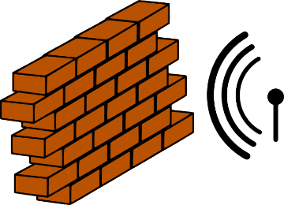
Challenges
Parametric systems
Faults
Channels
n
…
Notes:
Picking the right model to make verification easier
Parametric systems: undecidable in general
Interleavings: combinatorial blow-up
Channels: undecidable if FIFO, non-primitive recursive if lossy

Slide 21
1st try
The distributed algorithms community is working on solving these challenges. Let’s look for solutions there.
State-machine replication:
Everybody agree on the next action
Execute the action
Goto 1
Step 1 requires coordination (step 2 is purely local)

Slide 22
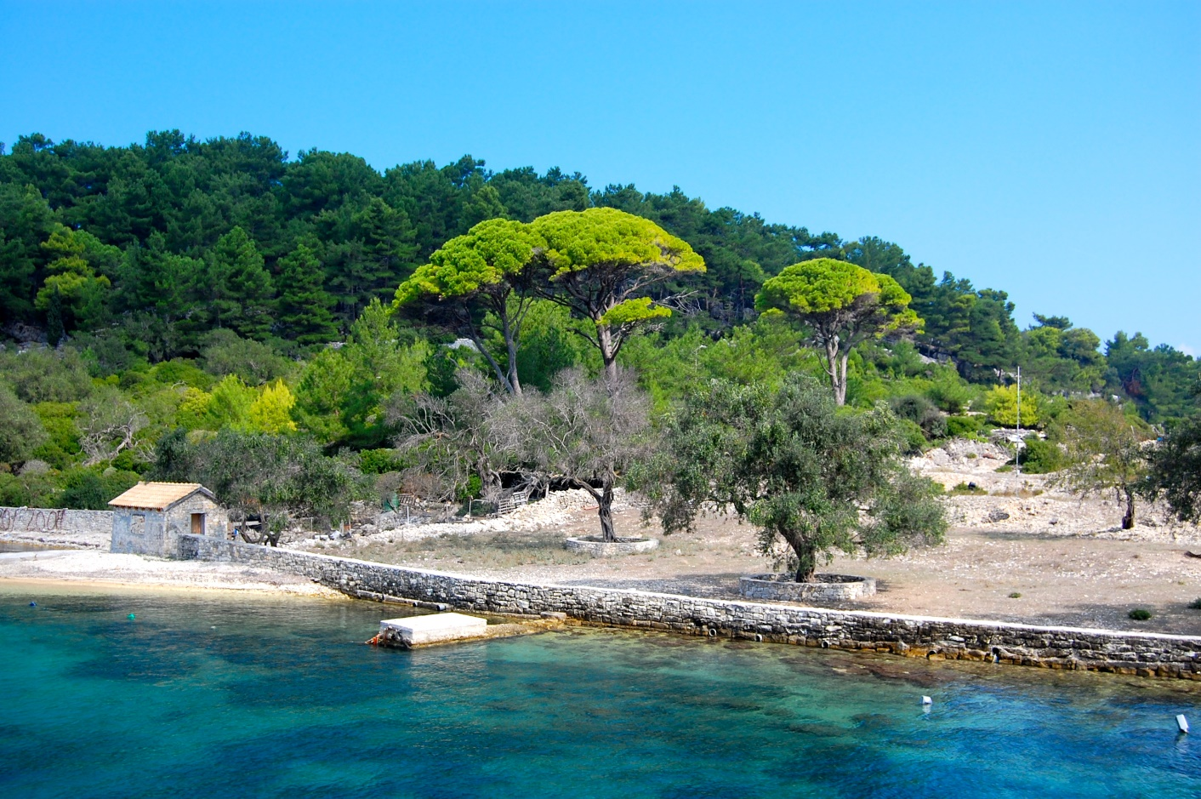
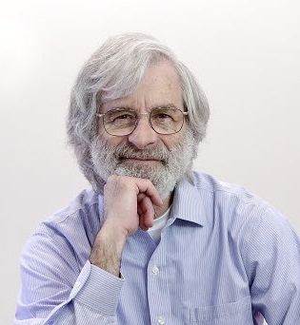
Our journey starts on the island of Paxos
where archeologists made an interesting discovery about a parliament system …
CC-BY-SA-NC Matt Taylor Copyright ACM
Notes:
Our original goal was just the verification of implementation of existing algorithms.

Slide 23
But it is also famous for confusing people
The part-time parliament [Lamport 98]
Paxos made simple [Lamport 01]
Paxos made live: An engineering perspective [Chandra et al. 07]
In search of an understandable consensus algorithm [Ongaro and Ousterhout 14]
Paxos made moderately complex [van Renesse and Altinbuken 15]
...
Need a simpler, less confusing abstraction
Notes:
Paxos is also know to confuse people

Slide 24
Structure of distributed algorithms: Communication-closed Rounds
Prepare
Promise
Accept
Accepted
Proposer
Acceptor
Acceptor
A round defines a scope for messages.
[Elrad & Francez 82]: decomposition of algorithm in communication-closed rounds.
The Heard-Of model [Charron-Bost & Schiper 09]
Notes:
Round defines a *scope* for the messages

Slide 25
Faults: the environment as an adversary
Semantics:
Compiler + runtime
Execution:
Notes:
Implementation in an asynchronous world
Asynchrony: no round structure, delays and buffering of messages
Failure detectors to recover some degree of synchrony

Slide 26
PSync: current status
Basic blocks:
Groups: set of robots communicating with each other
Rounds: unit of communication (and synchronization)
Make non-reliable communication explicit
Get ride timeout and exception handlers that nobody writes
Scope of the project is distributed systems in general
Tested on Paxos-type of algorithms
Also a story about verification
Integration with React still needs to be done
React is (soft) real-time
PSync uses logical time

Slide 27
Status
React: https://github.com/aleksandarmilicevic/react-lang
Existing backend: ROS, robot compiler
On top of scala/jvm (Arduino needs an external controller)
Future backend: beaglebone, raspberry-pi
PSync: https://github.com/dzufferey/round
On top of scala/jvm

